Slide 1
Warm up – (HW review from yesterday)
Mary babysits for $4 per hour. She also works as a tutor for $6 per hour. She is only allowed to work 12 hours per week. She wants to make at least $60. Write and graph a system of inequalities to represent this situation. Then, use your graph to name the best combination of hours that Mary should work.

Slide 2
Linear Inequality Test Review!

Slide 3
Race to the board review!
Pick a team consisting of 3-4 people.
Each team will have a dry erase board that you will use to work out each problem.
I will display the problem up on the promethean board.
The first person to write the correct answer on the board and show it to me wins a point for his/her team.
The catch: the students with the dry erase board only get one try. If every group misses the question, I will take the answer from the first person In the audience who raises his hand.
Winning team wins davison dollars!!!

Slide 4
Solving Linear Inequalities
Solve the inequality, then plot on the number line.
-5x + 2 > 22

Slide 5
Solving Linear Inequalities
Solve the inequality, then plot on the number line.
3(4x – 2) ≥ 18

Slide 6
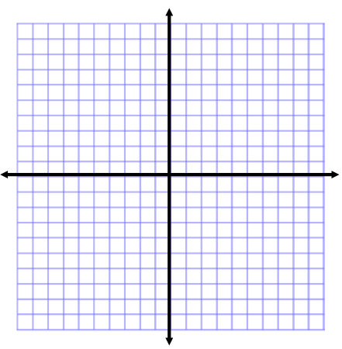
Graphing Linear Inequalities
Sketch the graph and shade the correct region. Then list two solutions and two non-solutions.
y < -2/3x + 3

Slide 7
Graphing Linear Inequalities
Sketch the graph and shade the correct region. Then list two solutions and two non-solutions.
-x + 2y ≤ 8

Slide 8
Graphing Systems of Linear Inequalities
Sketch the graph and shade the correct region. Then list two solutions and two non-solutions.
y > 1/3x + 2
y ≥ -2x + 3

Slide 9
Graphing Systems of Linear Inequalities
Sketch the graph and shade the correct region. Then list two solutions and two non-solutions.
y ≤ 2x + 1
y > -x -1

Slide 10
Application of Linear Systems of Inequalities
Jonah is going to the store to buy bags of candy for a party. Small bags cost $5 and large bags cost $10. He needs to buy at least 8 bags, and he cannot spend more than $50.
Write a system of linear inequalities that represent the situation.
Inequality #1 (hint: money equation):
Inequality #2 (hint: number of bags equation):

Slide 11
Application of Linear Systems of Inequalities
Jonah is going to the store to buy bags of candy for a party. Small bags cost $5 and large bags cost $10. He needs to buy at least 8 bags, and he cannot spend more than $50.
Graph both inequalities on a coordinate plane and shade the intersection.

Slide 12
Application of Linear Systems of Inequalities
What is one possibility that fulfills this situation? Write your answer as an ordered pair, and describe your answer using a complete sentence.

